Slide 1
Working with the web part property pane
Working with the web part property pane

Slide 2
Agenda
Overview
Implementing property fields
Handling property field changes
Q&A

Slide 3
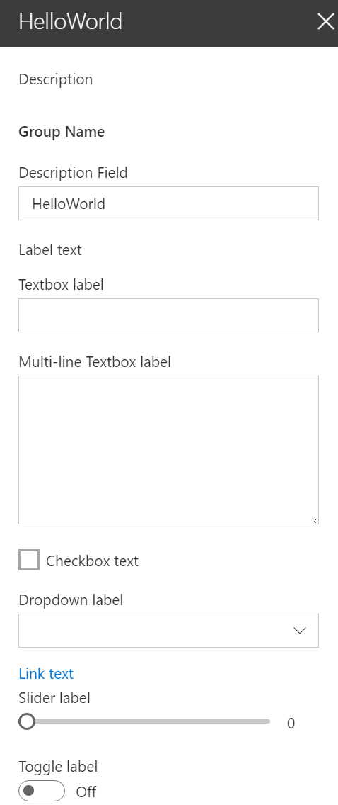
Overview
The property pane has three key elements
Pages, Headers, Groups
Property panes must contain a page and at least one group, the header is optional
The property pane supports the following field types
Label
Textbox
Multi-line Textbox
Checkbox
Dropdown
Link
Slider
Toggle
Custom
Notes:
Pages: Separate pages in a single property pane. Pages contain a Header and Groups.
Headers: The title of the property pane
Groups: Sections in the property pane that group properties

Slide 4
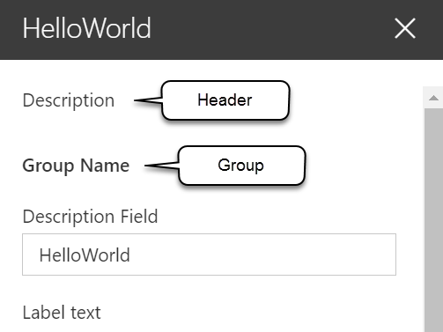
Implementing the header, groups, and fields
protected get getPropertyPaneConfiguration(): IPropertyPaneConfiguration {
return {
pages: [
{
header: {
description: strings.PropertyPaneDescription
},
groups: [
{
groupName: strings.BasicGroupName,
groupFields: [
PropertyPaneTextField('description', {
label: strings.DescriptionFieldLabel
}),
PropertyPaneLabel('labelField', {
text: 'Label text'
})
]
}
]
}
]
};
}

Slide 5
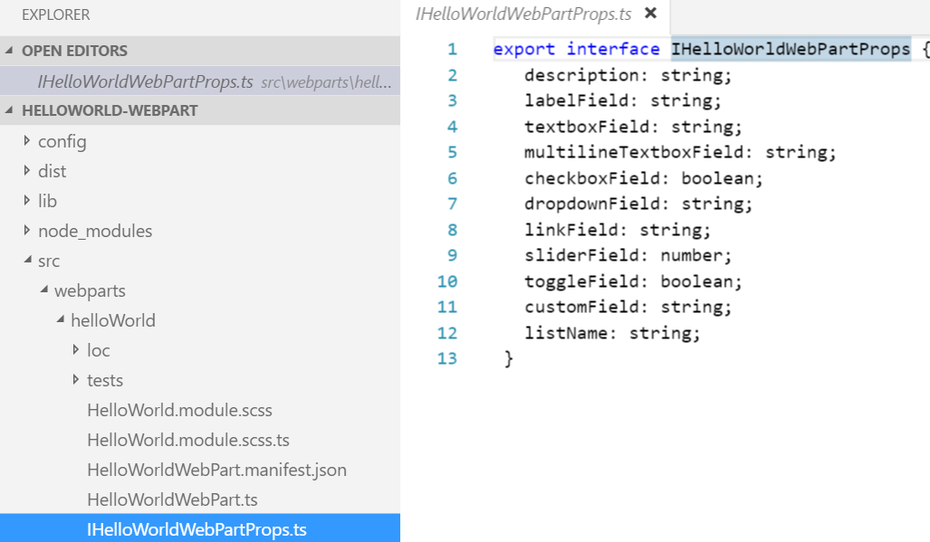
Implementing properties
Define an interface in your web part that includes one or more target properties

Slide 6
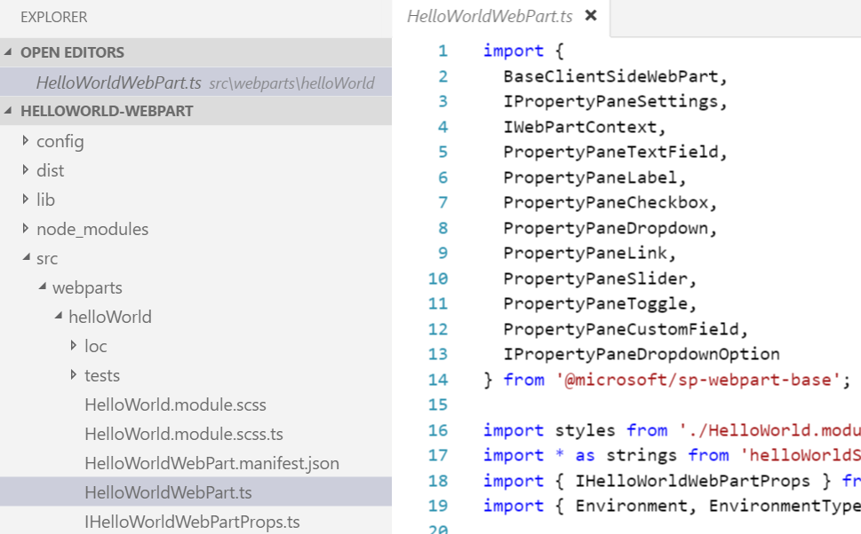
Implementing properties
Import the corresponding field types in the web part class
Field types are available as modules in the sp-webpart-base library

Slide 7
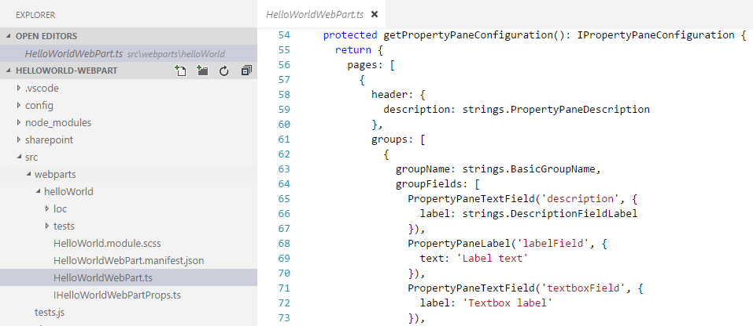
Implementing properties
Modify the default getPropertyPaneConfiguration method and add the properties to the groupFields array

Slide 8
Handling property field changes
The property pane has two interaction modes:
Reactive
Non-reactive
In reactive mode, on every change, a change event is triggered.
Reactive behavior automatically updates the web part user interface with the new property field values.
Non-reactive mode does not update the web part user interface automatically unless the user confirms the changes.
While reactive mode is sufficient for many scenarios, at times you will need non-reactive behavior.

Slide 9
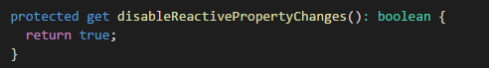
Property pane modes
The property pane is in reactive mode by default
You can override the default behavior by adding the disableReactivePropertyChanges method to the web part class

Slide 10
Angular web parts configuration properties differences
In non-Angular web parts
configuration is dynamic and can be changed after application bootstrap
In Angular web parts
configuration is static and is often done using angular.module().value() or .constant()

Slide 11
Adding configuration properties to Angular Client-Side web parts – one way of doing it
In the web part render function
Store a reference to the angular $injector
this.$injector = angular.bootstrap()
Broadcast configuration changed events on the $rootScope
this.$injector.get('$rootScope').$broadcast('configurationChanged', {
prop1: this.properties.prop1,
prop2: this.properties.prop2
})
In the Angular application, monitor the event and refresh the application $rootScope.$on('configurationChanged', function (event, args) {
// args.prop1, args.prop2
})

Slide 12
Adding configuration properties to React Client-Side web parts
Define the property in the web part manifest
{
"$schema": "../../../node_modules/@microsoft/sp-module-interfaces/lib/manifestSchemas/jsonSchemas/clientSideComponentManifestSchema.json",
"id": "b64ff4a0-5f1c-4cd9-b959-613a0a6d95c9",
"alias": "HelloWorldWebPart",
"componentType": "WebPart",
"version": "0.0.1",
"manifestVersion": 2,
"preconfiguredEntries": [{
"groupId": "b64ff4a0-5f1c-4cd9-b959-613a0a6d95c9",
"group": { "default": "Under Development" },
"title": { "default": "HelloWorld" },
"description": { "default": "HelloWorld description" },
"officeFabricIconFontName": "Page",
"properties": {
"description": "HelloWorld"
}
}]
}

Slide 13
Adding configuration properties to React Client-Side web parts
Modify the default propertyPaneSettings method and add the property to the groupFields array
protected get propertyPaneSettings(): IPropertyPaneSettings {
return {
pages: [
{
header: {
description: strings.PropertyPaneDescription
},
groups: [
{
groupName: strings.BasicGroupName,
groupFields: [
PropertyPaneTextField('description', {
label: strings.DescriptionFieldLabel
}),

Slide 14
Adding configuration properties to React Client-Side web parts
Pass the property value to React component when the React component is created
public render(): void {
const element: React.ReactElement<IHelloWorldWebPartProps> = React.createElement(HelloWorldComponent, {
description: this.properties.description
});
ReactDom.render(element, this.domElement);
}

Slide 15
Adding configuration properties to React Client-Side web parts
Handle the property values in the React component when the component starts and whenever the property value is updated
public componentDidMount(): void {
this.doSomething(this.props.description);
}
public componentDidUpdate(prevProps: IHelloWorldWebPartProps, prevState: IHelloWorldWebPartState): void {
if (this.props.description !== prevProps.description) {
this.doSomething(this.props.description);
}
}
private doSomething(description: string): void {
// Do something with the property
}

Slide 16
DEMO
Working with the web part property pane
Notes:
Use Exercise 1: Working with the web part property pane in the lab manual.

Slide 17
Summary
Overview
Implementing property fields
Handling property field changes
Q&A

Slide 18

Sharing is caring…
Code samples and solutions
Reusable components
Guidance documentation
Monthly community calls
SharePoint Framework
SharePoint add-ins
Microsoft Graph
Office 365 APIs
http://aka.ms/SharePointPnP

Slide 19

Q&A

Slide 20


